Slide 1
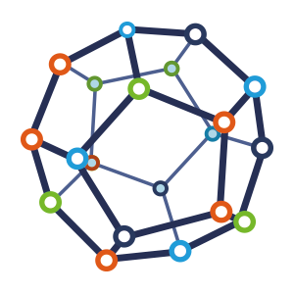


Computer Network
Class VI
lab 1

Slide 2

What is Network
a group or system of interconnected people or things

Slide 3
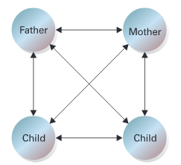
Human Networks
there may be a single network like family where many attributes (father, mother, sister, brother etc) are connected to each other

Slide 4
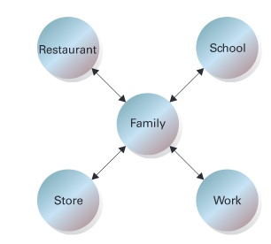
Peer Networks
a single network can be connected with another network

Slide 5
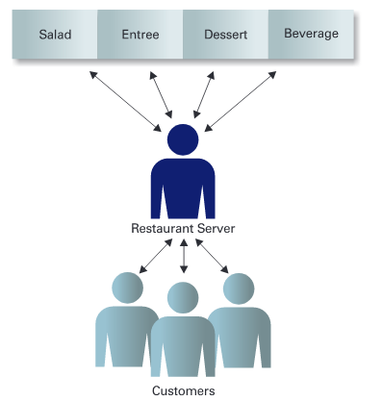
Client and the Server
server provides something and client get that by the help of media

Slide 6
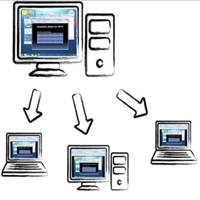
Computer Network
Share resources from one computer to another

Slide 7
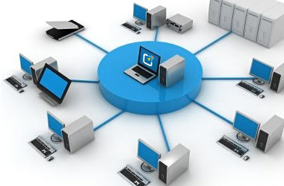
Computer Network
Store files in one computer and access those files from other computers

Slide 8
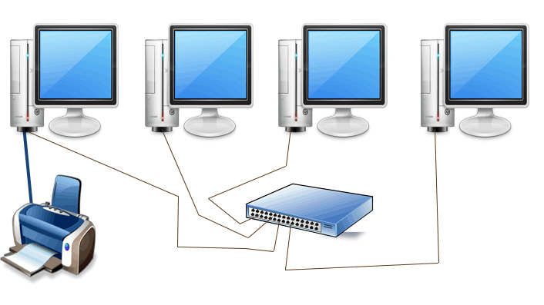
Computer Network
Connect a printer, scanner, or a fax machine to one computer and access them from other computer

Slide 9



